Slide 1
Problem identification:
How can Big Mountain resort increase their revenue?
Big Mountain Resort has recently increased their operating costs.
Hence, we must find new business strategies that will balance the incomes vs operating costs of the resort, and eventually increase the revenue.
To address this goal we used a dataset with information about different ski resorts across the US.
This data set includes tickets prices for the resorts, and a lot of other features, that some of them affect these prices, and it will enable us to assess our pricing comparing to other resorts.

Slide 2
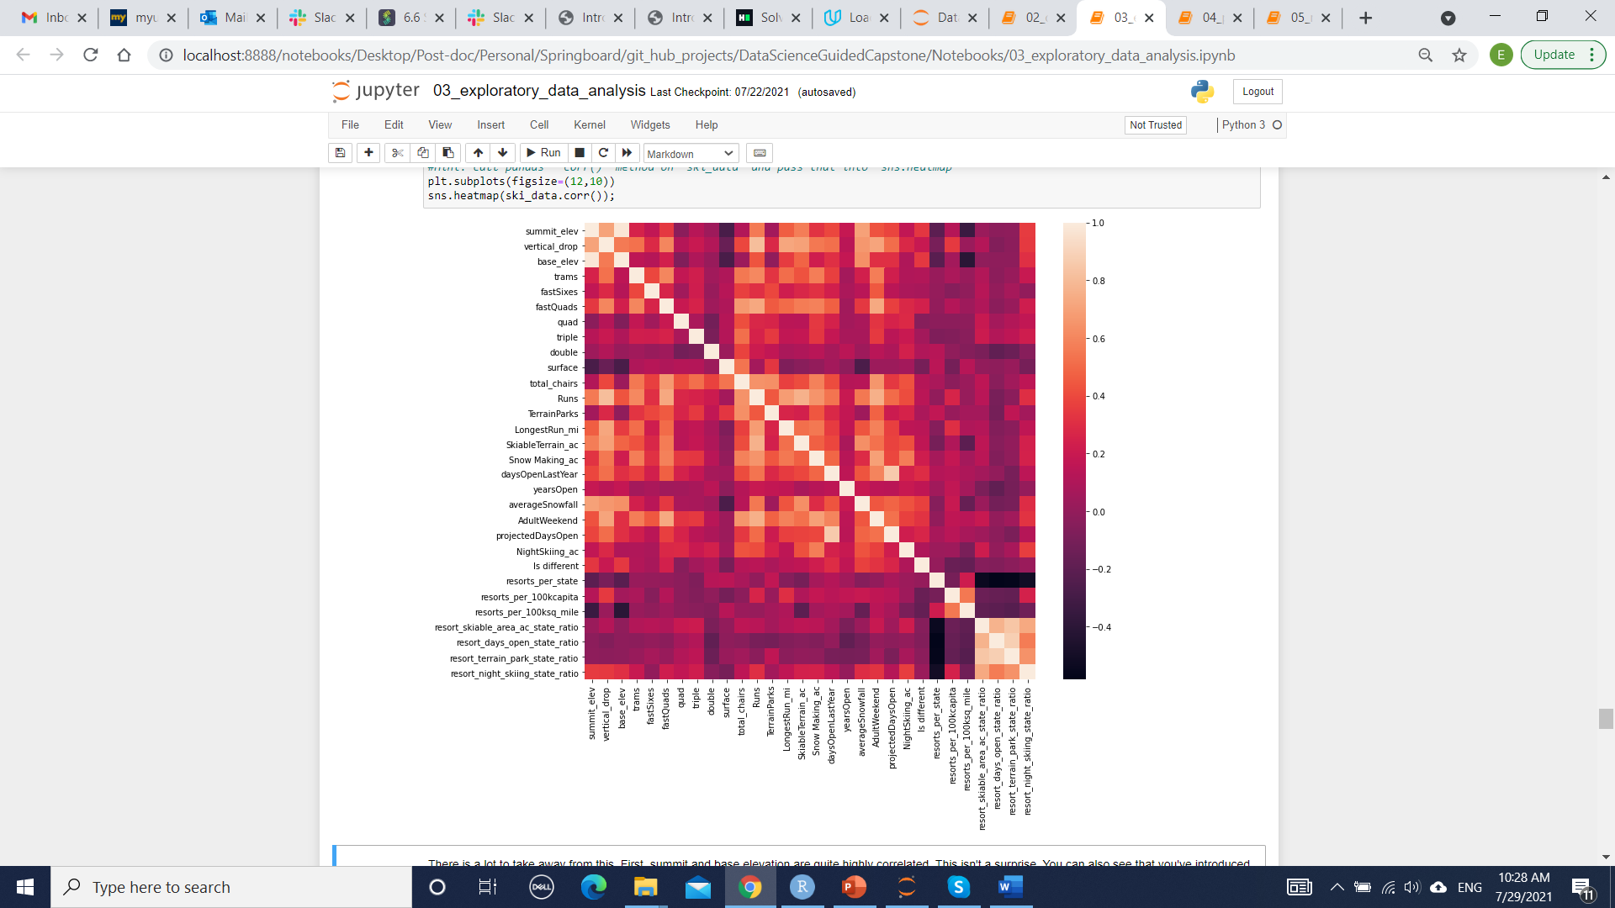
Recommendation and key findings
The current ticket price at the Big Mountain resort is $81.00 for an adult, though a model that we created based on the resorts data predicts that this price should be higher than that - around $95.52.
To understand what are the factors that will most likely affect ticket prices we checked the correlation between the price and the different feature.
This analyzes revealed several features that can be correlated with ticket prices:
vertical_drop
Snow Making_ac
total_chairs
fastQuads
Runs
LongestRun_mi
trams
SkiableTerrain_ac

Slide 3
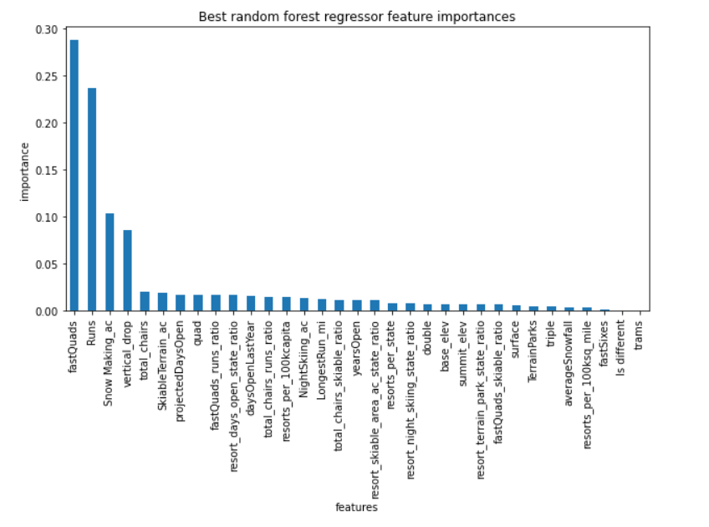
Modeling results and analysis
We build several machine learning models to assess how each of these features affect the price, and eventually we decided to use the random forest model.
This model highlighted the most important features to our analyzes:

Slide 4
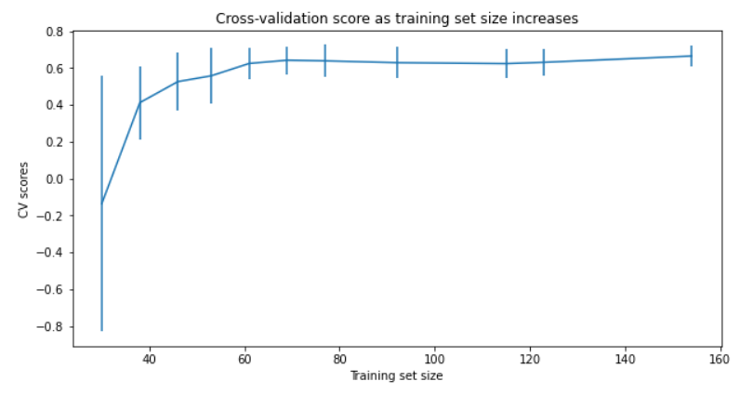
Modeling results and analysis
Our analyzes shows that have plenty of data, and we can use our model with the data that we have to assess our questions.

Slide 5
Modeling results and analysis
Using our model we reviewed the following potential scenarios for either cutting costs or increasing revenue:
Permanently closing to 10 of the least used runs. This doesn't impact any other resort statistics.
Increase the vertical drop by adding a run to a point 150 feet lower down but requiring the installation of an additional chair lift to bring skiers back up, without additional snow making coverage
Same as number 2, but adding 2 acres of snow making cover
Increase the longest run by 0.2 mile to boast 3.5 miles length, requiring an additional snow making coverage of 4 acres

Slide 6
Summary and conclusion
We reviewed each of the above scenarios using our model, under the assumption that the expected number of visitors over the season is 350,000 and, on average, visitors ski for five days.
Based on our analyzes we can recommend two main options:
Closing 5 runs, as this will not affect ticket price, and will decrease the operating costs.
Increasing the vertical drop by 150 feet and installing an additional chair lift will cost the resort some initial and operating costs but will enable to resort to increase the ticket price in 1.57$ and over the season will result in an increase of $2750000.

